Slide 1
Video Games Analysis Centered Around Review Ratings, Genre Specification, and Monetization Models
Arij Ahmed, Qi Zhang, Ziyang Liu

Slide 2
Project Background
Genre Evolution: Which niche genres have transitioned to the mainstream over the past decade? What do their lifecycle trajectories look like?
Publisher Specialization: Is there a statistically significant correlation between a publisher’s genre focus and their financial performance?
Indie Breakthroughs: Through what types of genre innovation do indie titles achieve market breakthroughs?
Market Distribution: What is the statistical genre distribution among the Global Top 100 best-selling games across longitudinal trend lines?

Slide 3
Dataset & Data Cleaning
The analysis utilizes the following datasets:
Steam Insights (October 2024): A comprehensive database including game details, genres, reviews, tags, and SteamSpy insights. Source: NewbieIndieGameDev/steam-insights
Video Game Sales Dataset: A dataset analyzing sales data from more than 16,500 games from multiple platform(Xbox, PlayStation, Nintendo, etc.) Source: Kaggle - Video Game Sales

Slide 4
Cleaning Strategy
Robust CSV parsing The original datasets contain escaped quotes, HTML snippets, and multiline text, so we use escapechar='\\' and a stable parser when reading the CSV files.
Column selection We keep only the columns related to our research questions and drop unrelated columns.
Missing value normalization We convert \N, N, empty strings, None, and NaN into standardized missing values.
Type conversion We convert app_id, review counts, sales, and prices into numeric data types. We also convert game prices from cents to dollars, for example, from 999 cents to $9.99.
Normalization and deduplication The dataset contains genres and categories in multiple languages. We map and standardize these values into English, then remove duplicate records.

Slide 5
Table | Rows | Main Fields
games_clean.csv | 140,082 | app_id, name, release_date, is_free, developer, publisher, owners_range, price
genres_clean.csv | 353,339 | app_id, genre
tags_clean.csv | 1,744,632 | app_id, tag
categories_clean.csv | 522,569 | app_id, category
reviews_clean.csv | 140,082 | review score, positive/negative counts, Metacritic score
games_vgsales_matched.csv | 1,854 | Steam metadata + VG sales columns

Slide 6
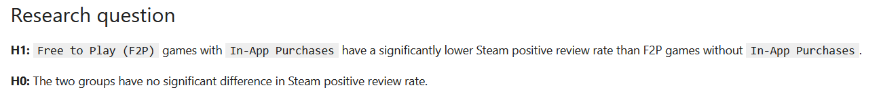
Hypothesis Testing with Monetization Models
To answer this, we have built four distinct buckets to help us understand monetization.

Slide 7
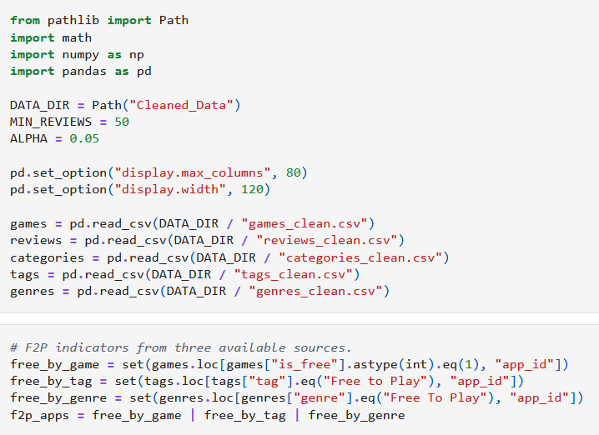
Loading the Data
Must define what F2P truly means
To do this, we must rely on a few columns across multiple tables
Grabbed "is_free" from games table, "Free to Play" from tags and genre tables

Slide 8
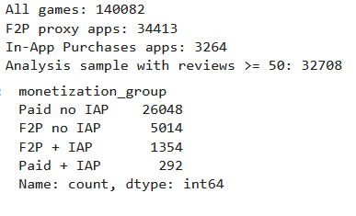
Output Explanation

Slide 9
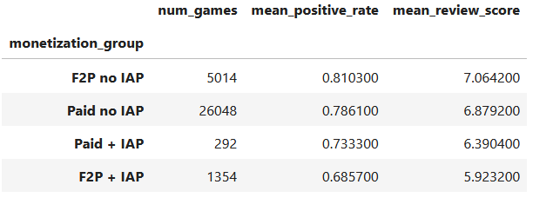
Descriptive Statistics

Slide 10
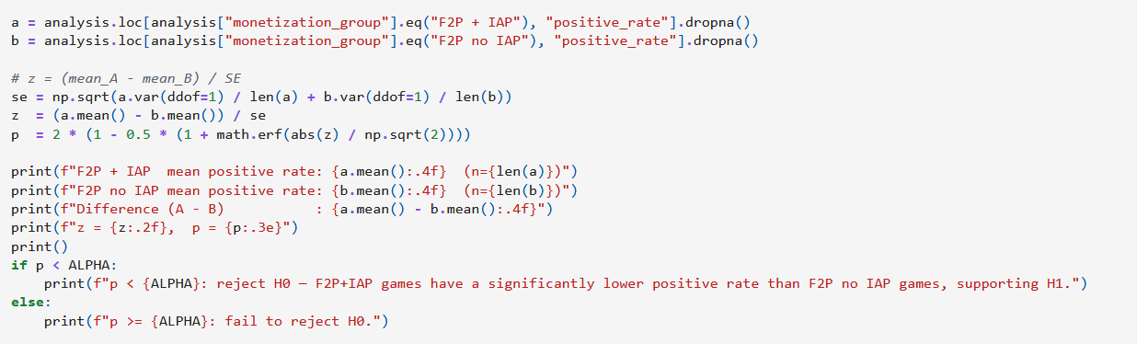
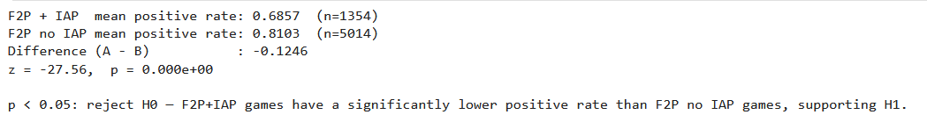
Primary Hypothesis Test

Slide 11
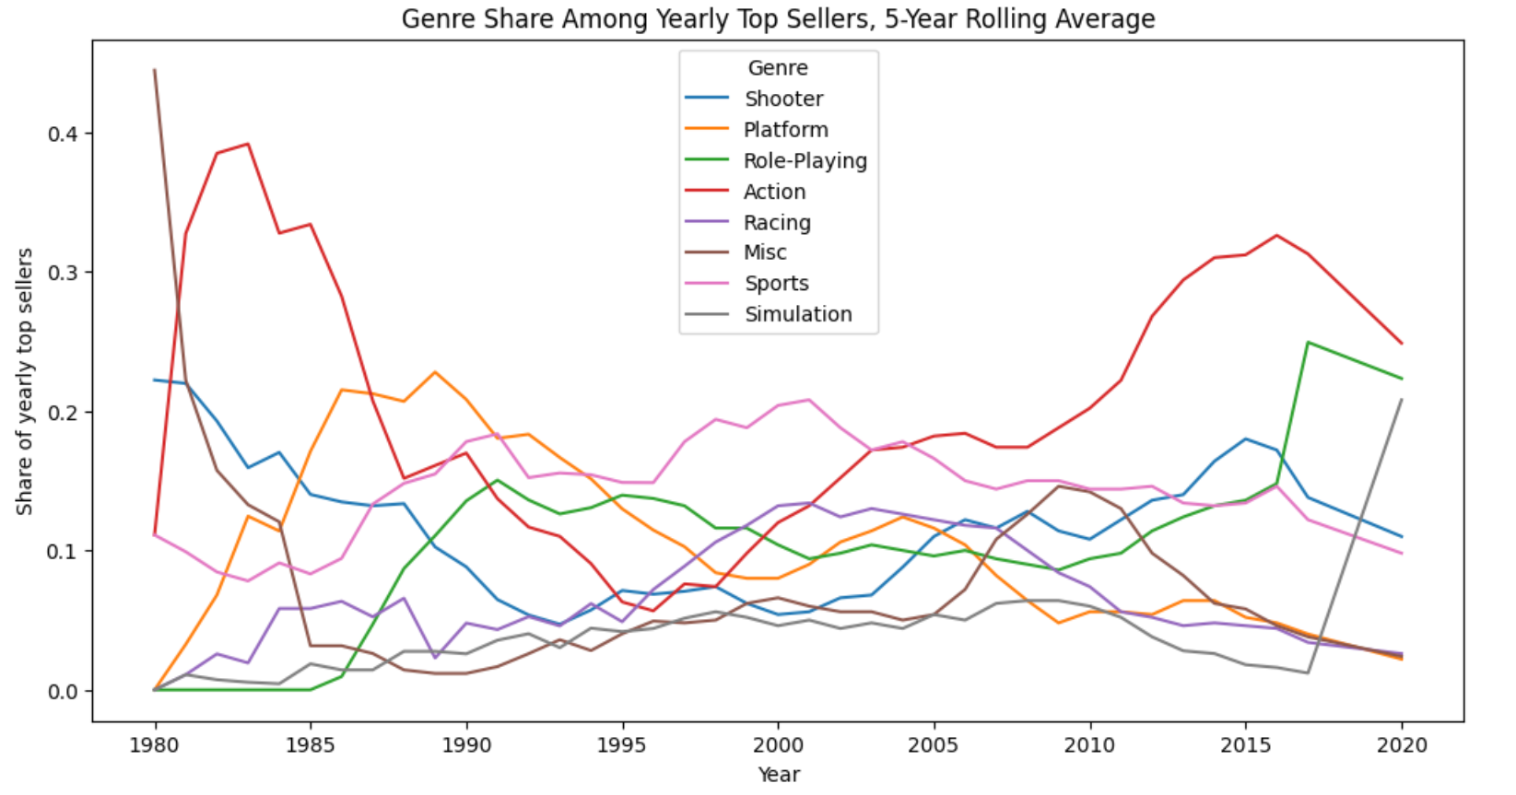
Genre Share Amongst Top Sellers (vgChartz)

Slide 12
Critic vs Player
Where do Steam player ratings and critic ratings systematically disagree — across titles, genres, publishers, price tiers, and years?

Slide 13
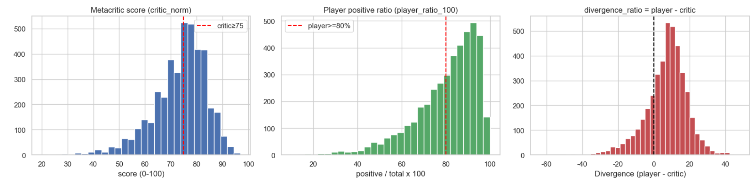
Rating Distribution
The Metacritic score distribution is slightly left-skewed but overall bell-shaped.
The player ratings distribution is strongly left-skewed, meaning that players are likely to rate high.
The divergence ratio, defined as player score minus critic score, is centered slightly above zero. This suggests that player evaluations are generally higher than critic evaluations.
Notes:
The score distribution on display in histogram 1 shows a dotted red line around the 75/100 mark, signifying the average Metacritic score across 4,155 games. The average critic score may seem low, but it appears that critics tend to avoid holding extreme positions with their reviews. Compare this to histogram 2 and we can see a clear and stark difference between how critics review games versus how players review games.
In histogram 2, there is a clear left-skew leaning towards games that are over 80% positive. Clearly, there aren't many negative reviews available to us. An assumption can be made about this: the average consumer is more likely to review a game that they deem as "positive" than a game that they perceive as "negative". Players may only feel inclined to review games that they enjoy over games that they may have issues with.
Histogram 3 shows us that the divergence ratio is slightly above the baseline of 0 that we've established. There is some credibility to be had in concluding that players are generally more positive and more likely to give a good review for a video game than the analysts over at Metacritic.

Slide 14
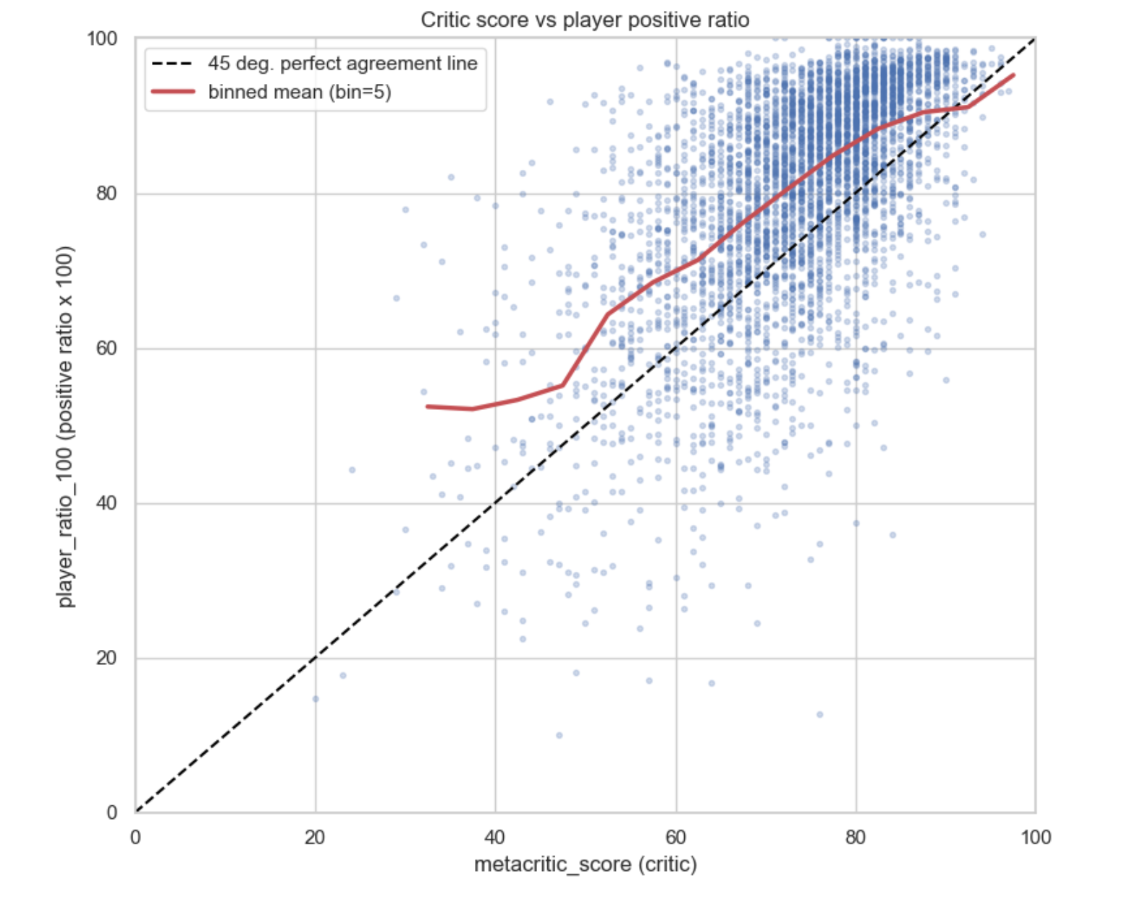
Metacritic Score vs Player Positivity Ratio
The dashed diagonal line represents perfect agreement between critic and player scores.
The red binned-mean line tracks player ratings and supports our earlier histogram finding that players are generally more positive than critics.
The line dips around a critic score of 90, possibly because highly acclaimed games attract more public attention and therefore more scrutiny or backlash.

Slide 15
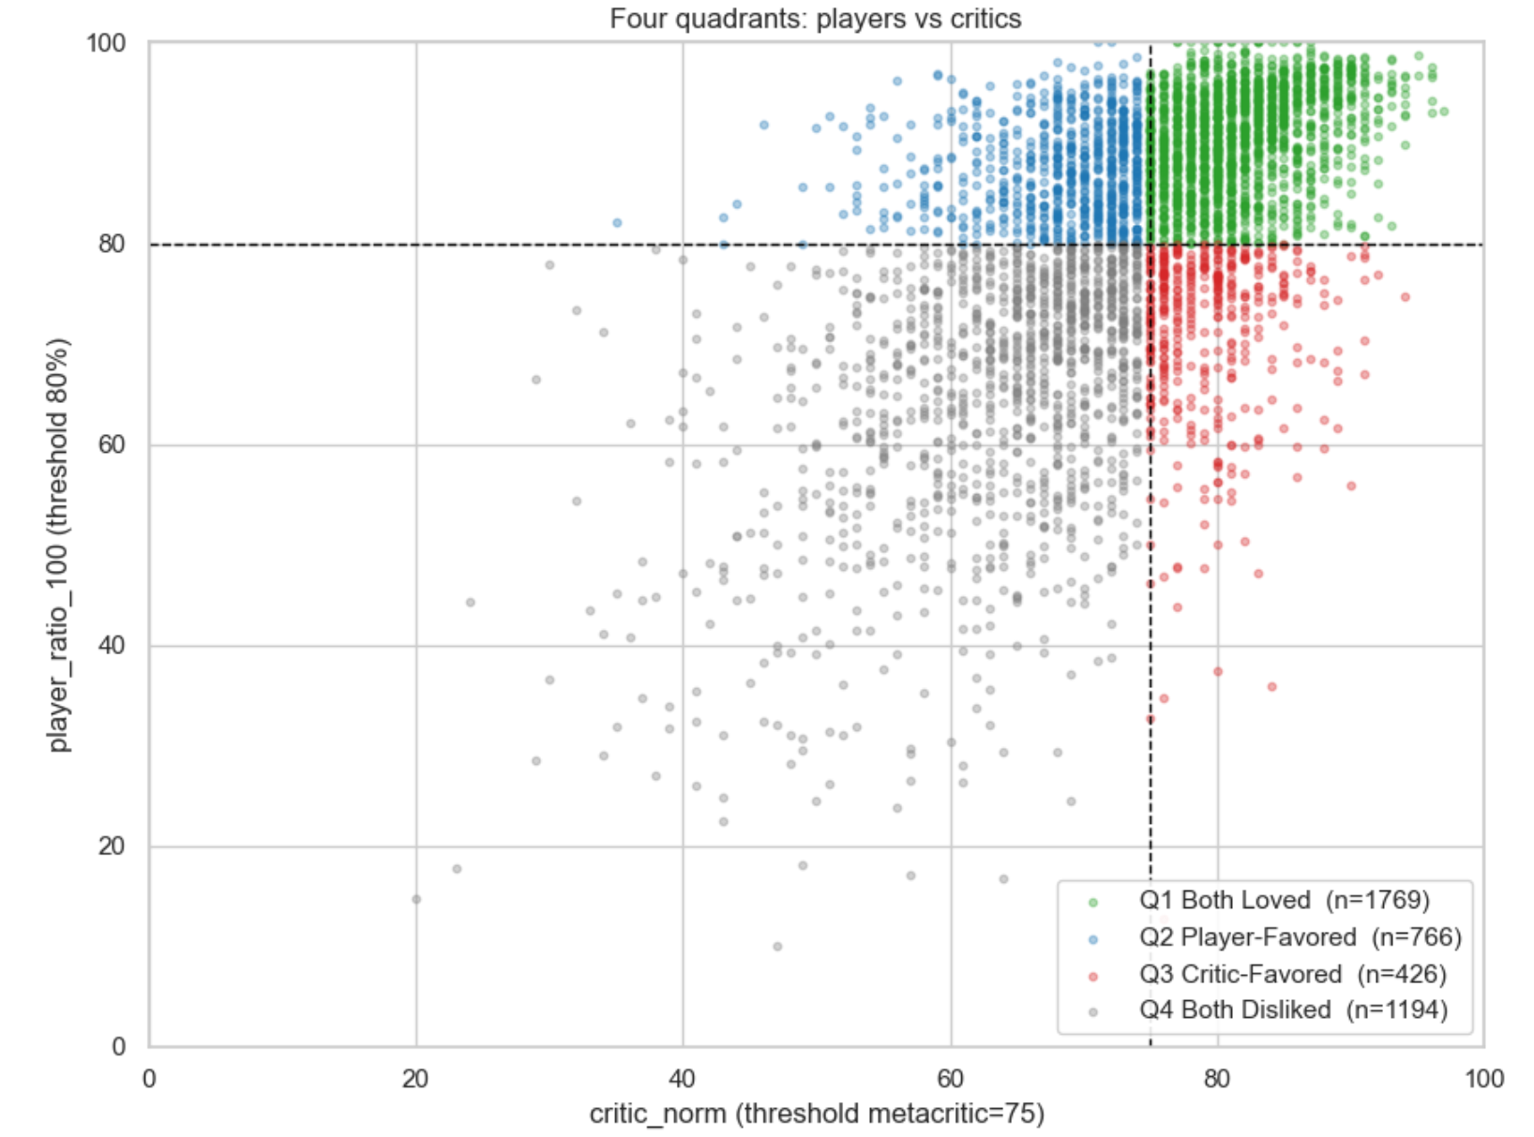
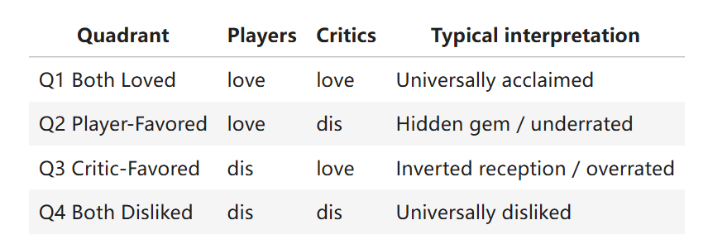
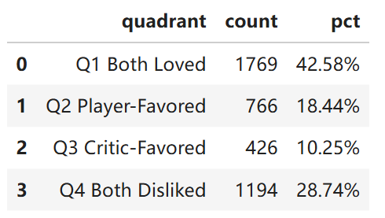
Four-Quadrant Split
Game Distribution in Each Quadrant

Slide 16
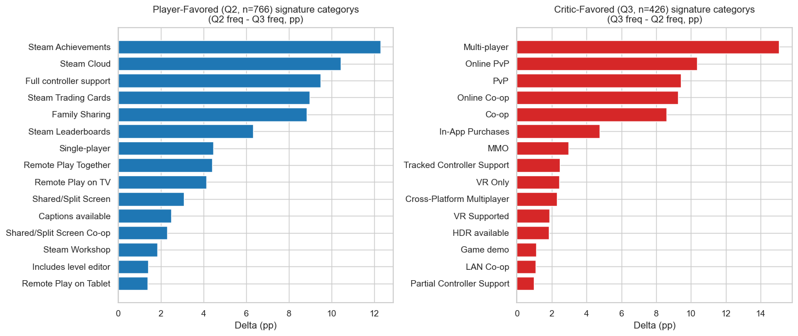
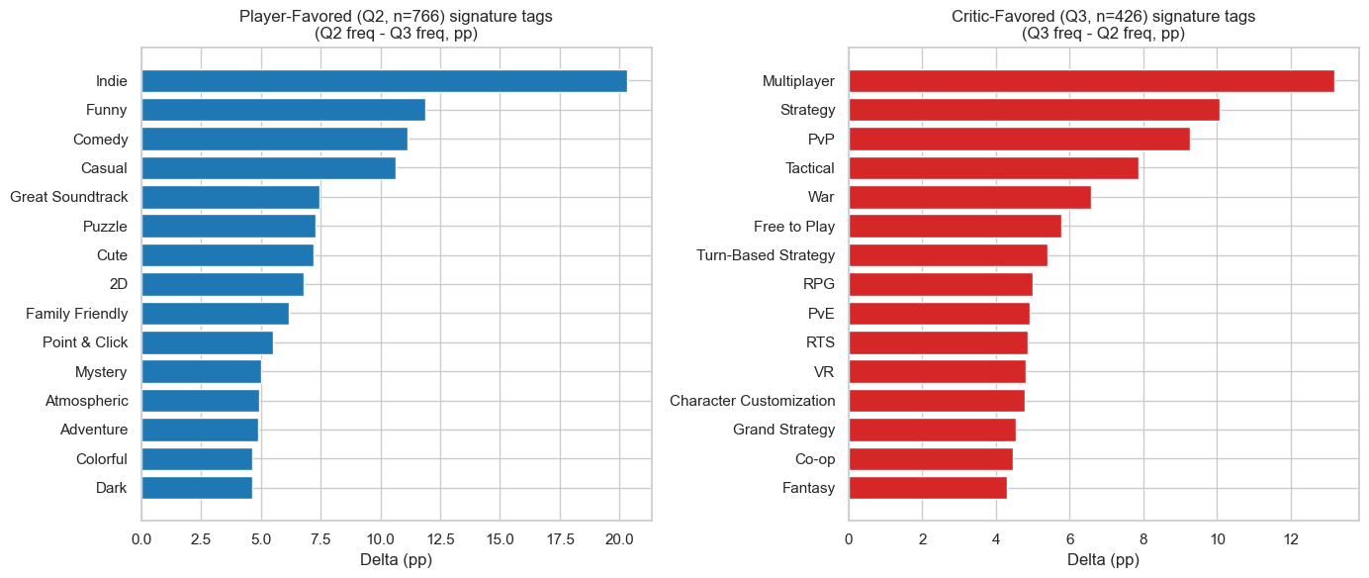
Slice by Category & Tag
Delta: Q2-Q3 freq
Q2: Player Favored
Q3: Critic Favored

Slide 17
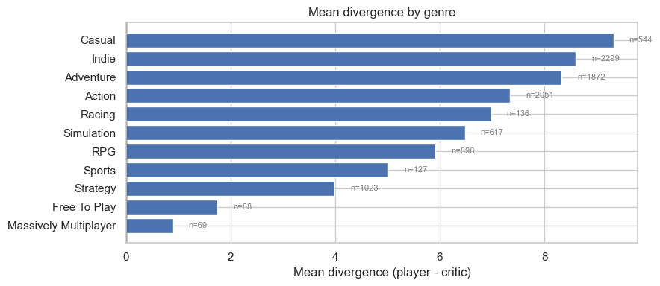
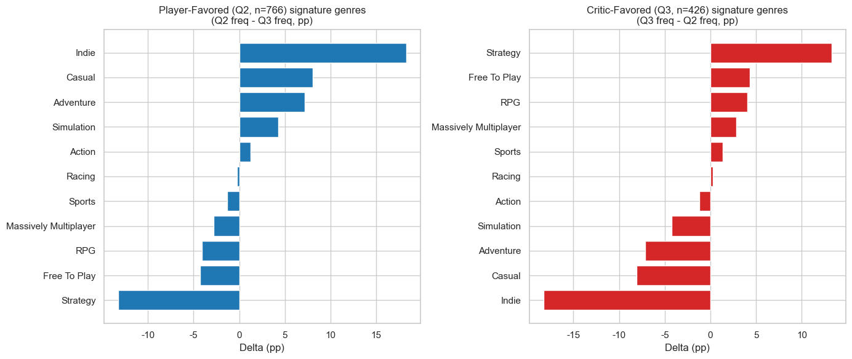
Slice by Genre

Slide 18
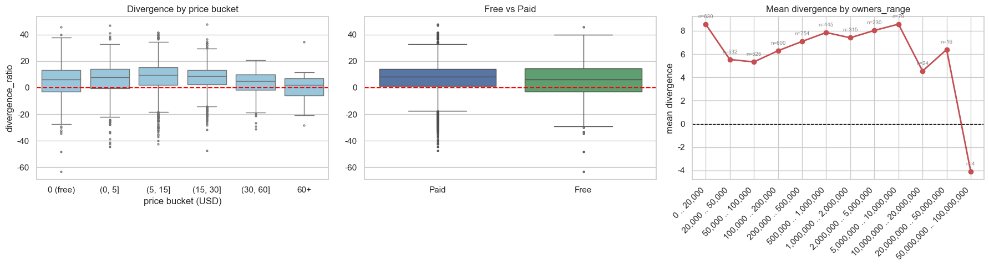
Divergence by Price, is_free and Owner Range
For cheaper games, players tend to be more forgiving.
Paid games have a slightly higher median divergence than free games, but the difference is not very large.
For owner ranges, mean divergence stays positive for most groups, indicating broad agreement with the earlier finding that players are more positive than critics. However, the largest owner range shows a sharp negative drop, likely because the sample size is very small, so this result should be interpreted carefully.

Slide 19
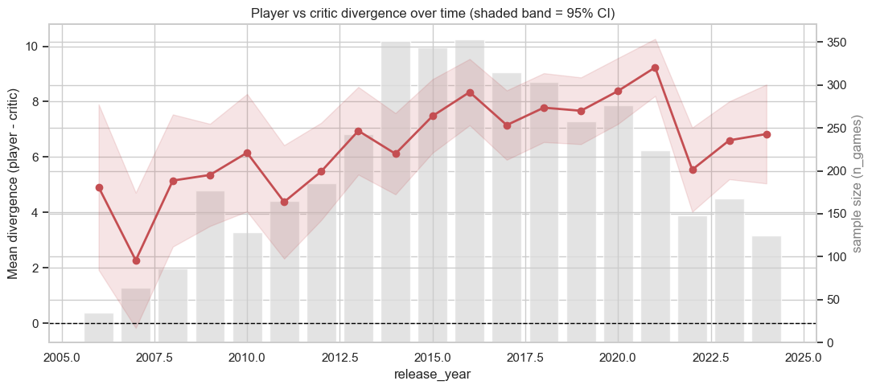
Trend by Release Year

Slide 20
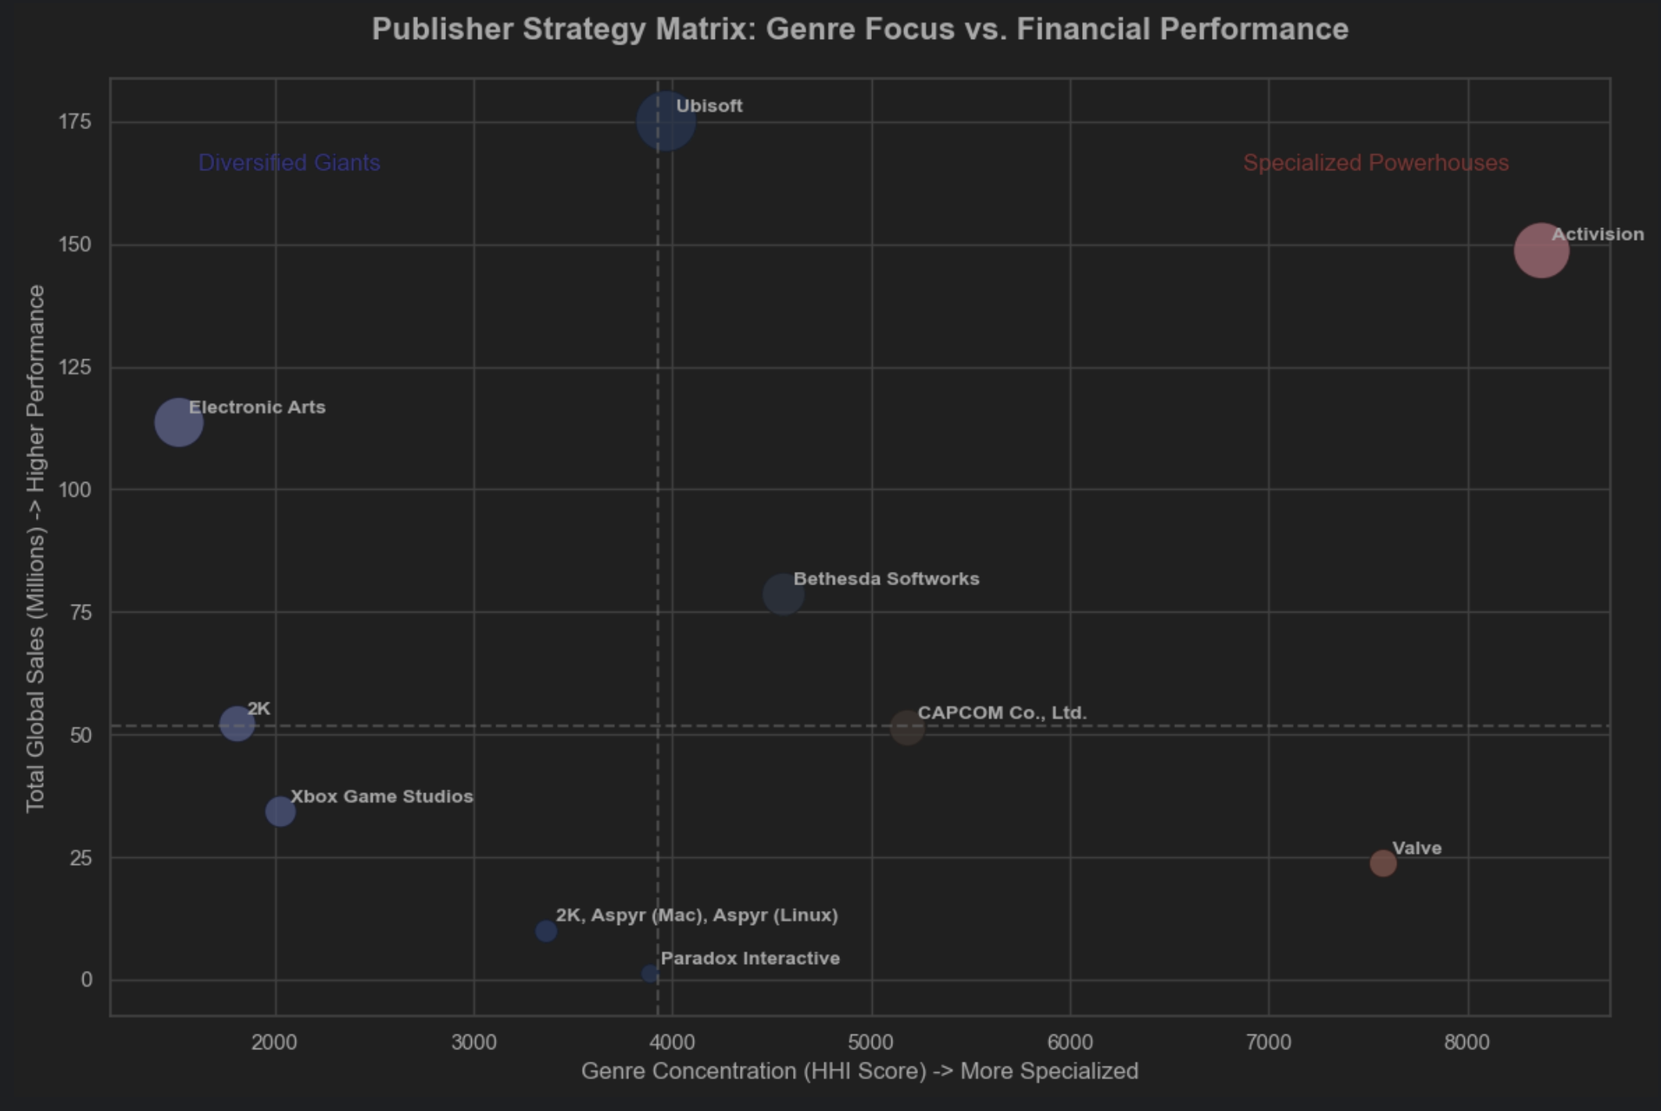
Publisher Strategy: Diversification vs. Specialization
Diversified Giants: Broad genre hedging (HHI ~1500) yields 110M+ total sales.
Special Powerhouses: Extreme focus on Action/Shooter (HHI ~8300) drives 148M+ sales.
Key Takeaway: Massive scale is achievable through focus and broad diversification.

Slide 21
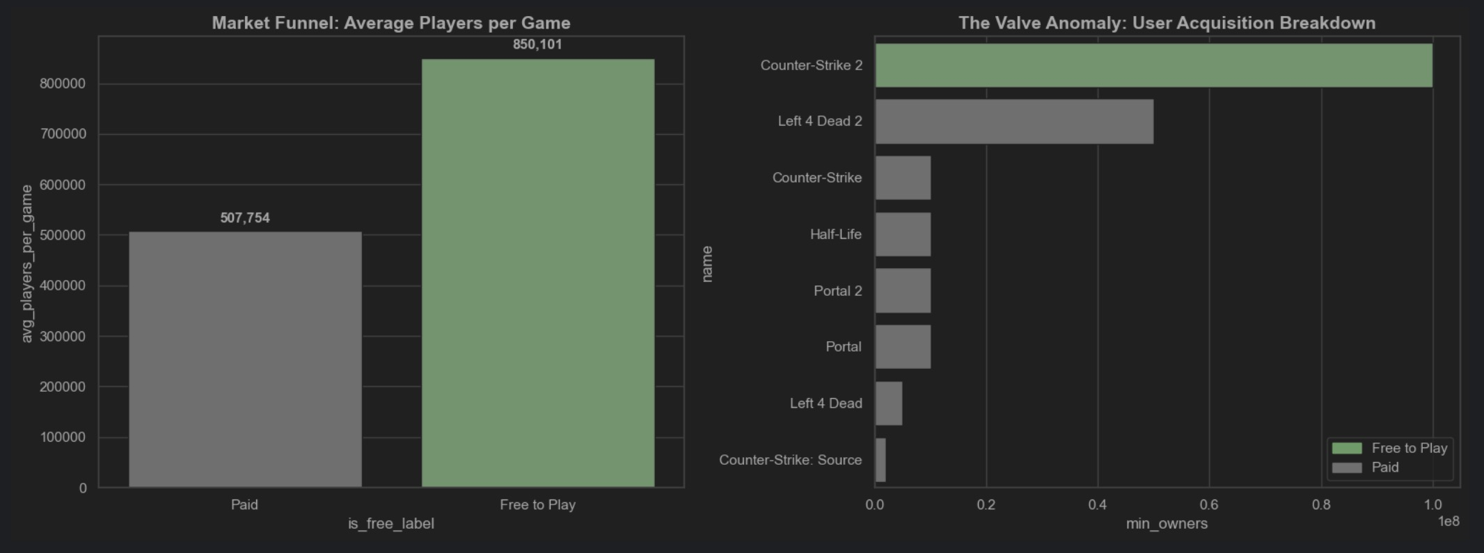
Free-to-Play and CS2 Dominance
F2P Success: F2P model drives 1.67x more average players per game globally than paid titles.
CS2 Dominance: Despite minimal buy-out sales, a single F2P title (CS2) captures 100M+ users.
Key Takeaway: Zero-barrier entry acts as a traffic black hole, locking users into lucrative virtual economies.

